Slide 1
SPyC: Simple Statistical Process Control System (CS50 Final Project)
Created by: Chris Wahrenburg
Github: https://github.com/cwahrenburg/spc
edX: cpw712
Madison, CT USA
March 27, 2026

Slide 2
Introduction / Problem
Definition:
Statistical process control (SPC) is defined as the use of statistical techniques to control a process or production method. SPC tools and procedures can help you monitor process behavior, discover issues in internal systems, and find solutions for production issues. (https://asq.org/quality-resources/statistical-process-control)
Basic Idea:
Patterns provide insight into underlying process behavior
https://en.wikipedia.org/wiki/Nelson_rules
Commonly applied in industry (e.g., manufacturing, healthcare, service, etc).
Challenge:
Complex manage/apply in real-time.

Slide 3
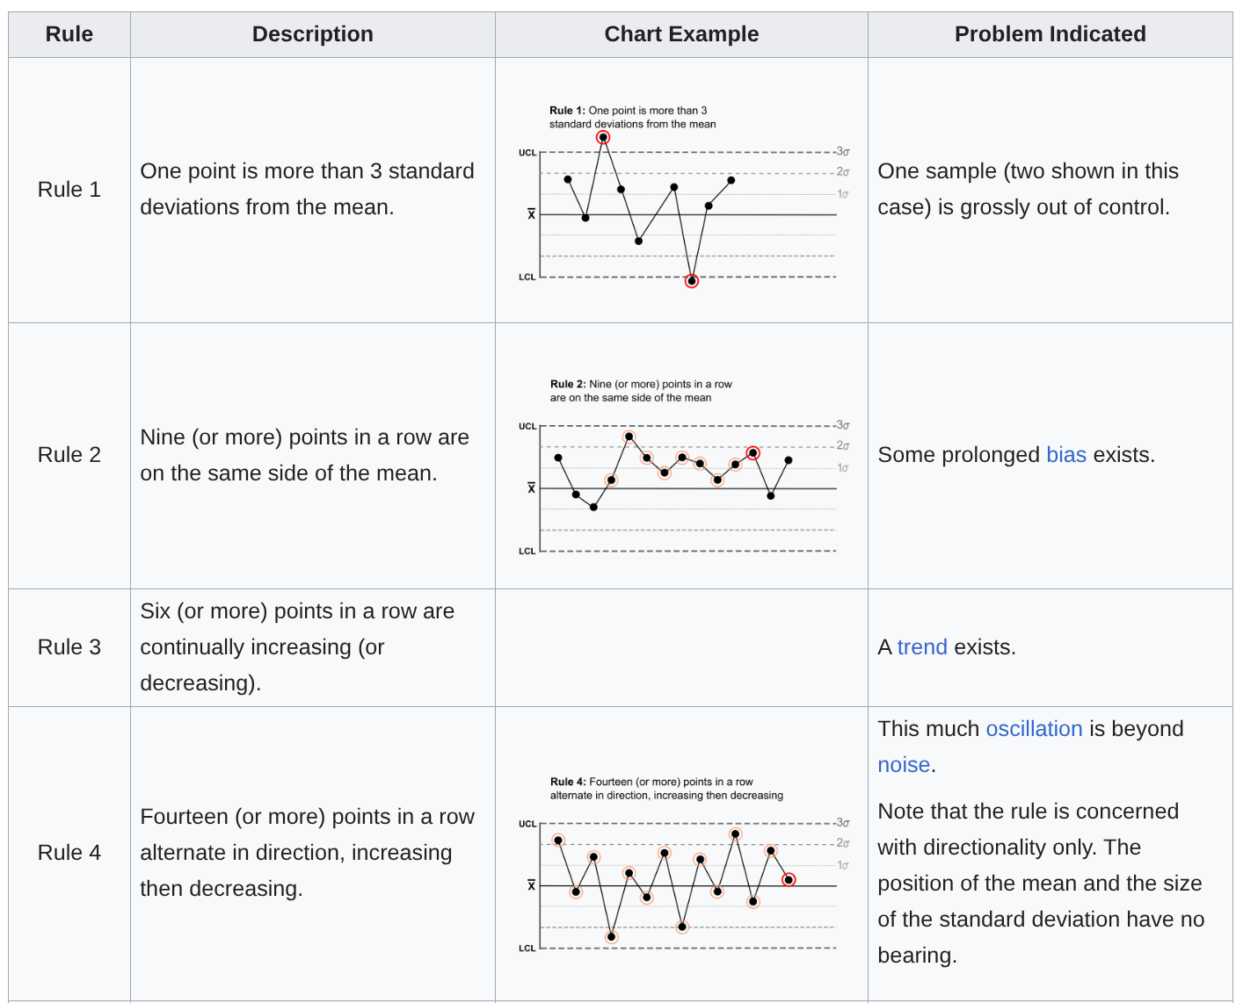
SPC Rules: Differentiate signal from noise. https://en.wikipedia.org/wiki/Nelson_rules

Slide 4
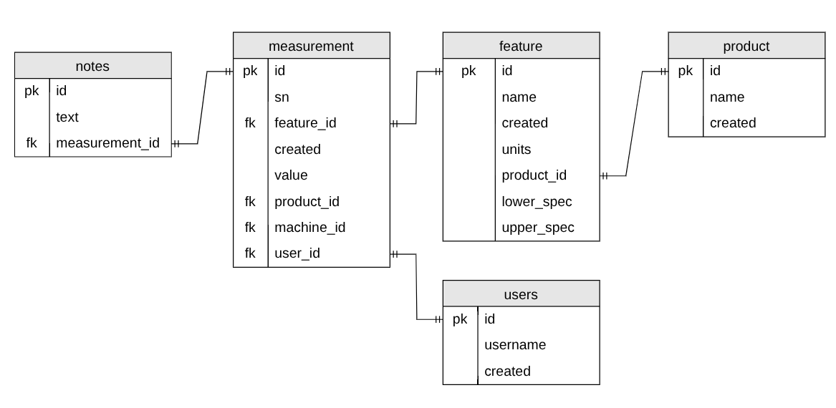
SPyC Under the hood
Purpose | Component
Database | SQLite
Web framework | Python / Flask / Jinja
Plot visualization | Plotly.io
Web Styling | Bootstrap CSS

